Slide 1
Camera module supported API'S
Presented by
C.KEERTHI KUMARI
T.BEERASWAMY

Slide 2
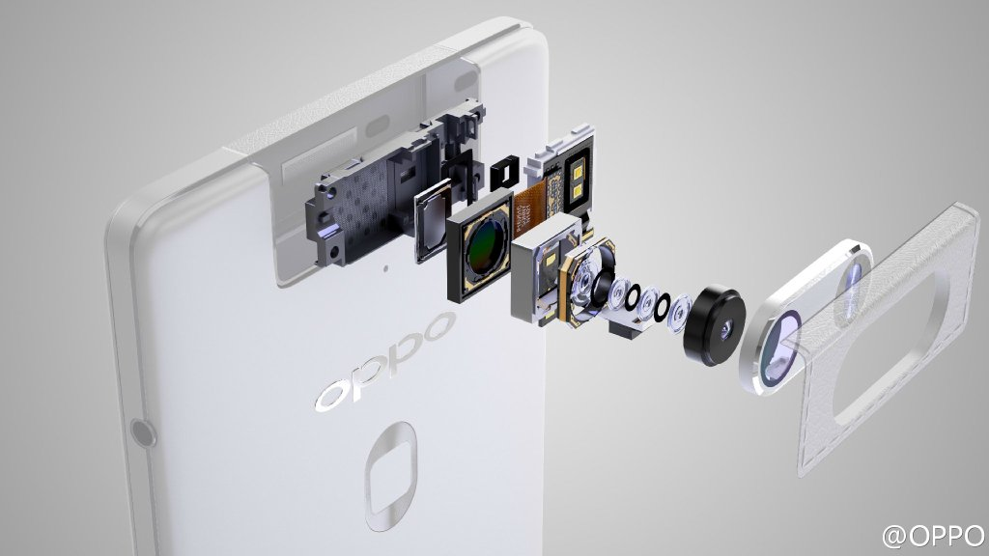
Introduction

Slide 3
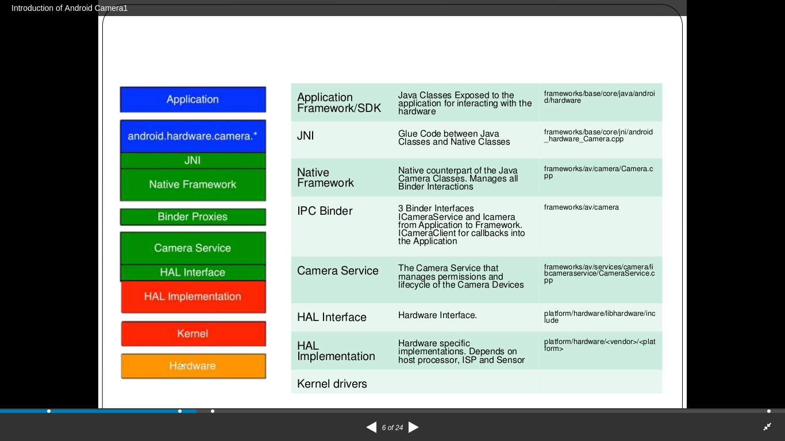
Architecture path of camera driver
2
3

Slide 4
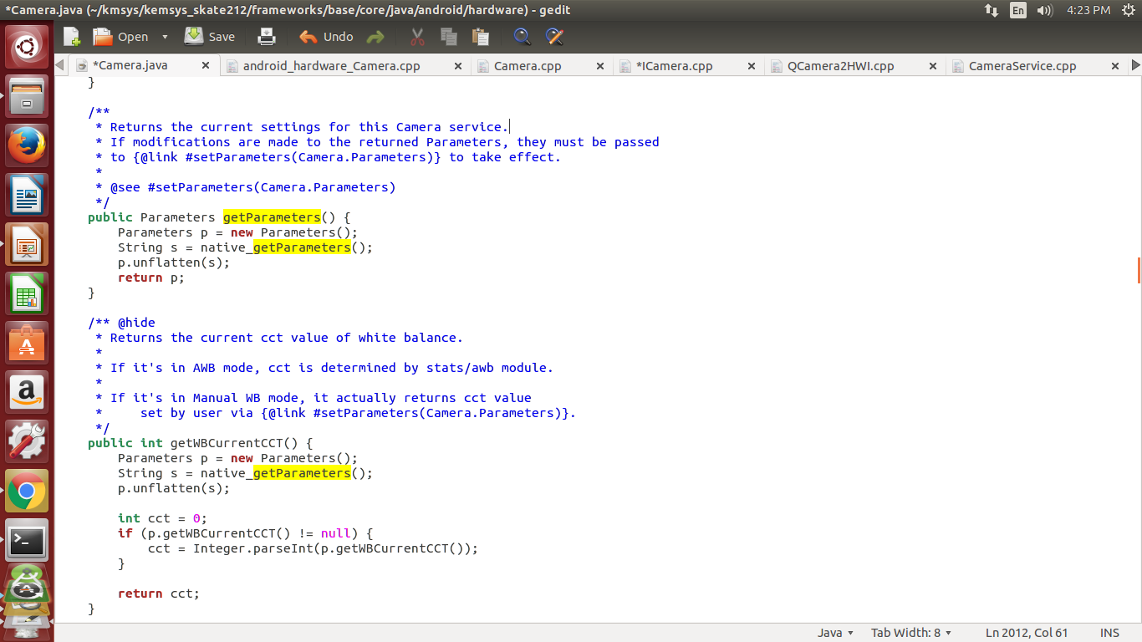
Appliction ---Framwork/base/core/java/android/hardware/camera.java

Slide 5
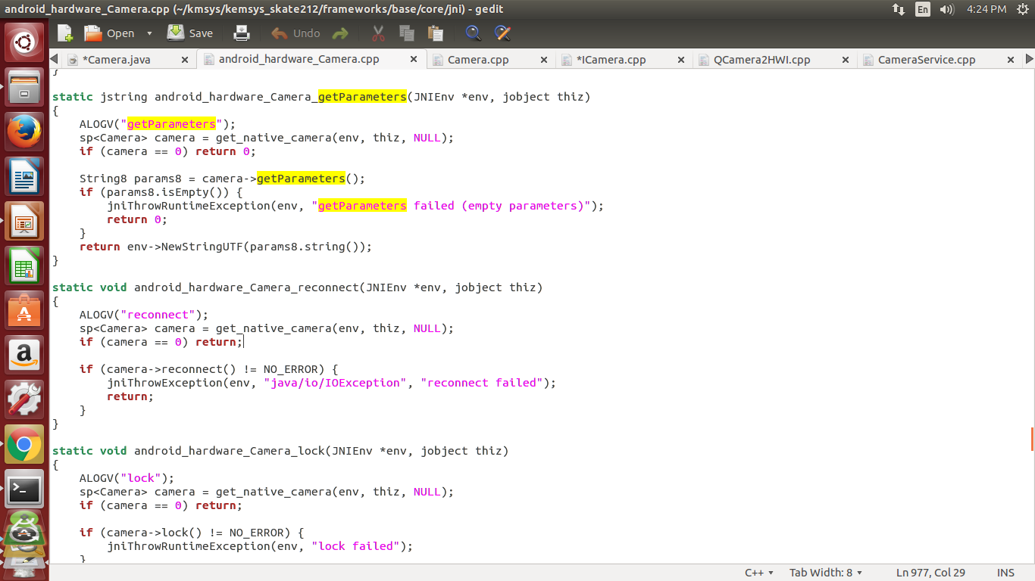
JNI ----Framwork/base/core/jni/android_hardware_camera.cpp

Slide 6
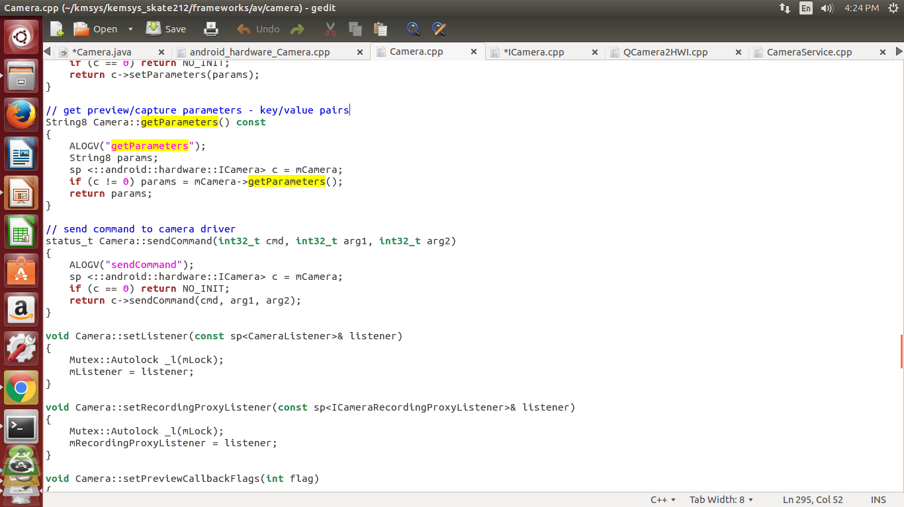
Native framwork---Framework/av/camera/camera.cpp

Slide 7
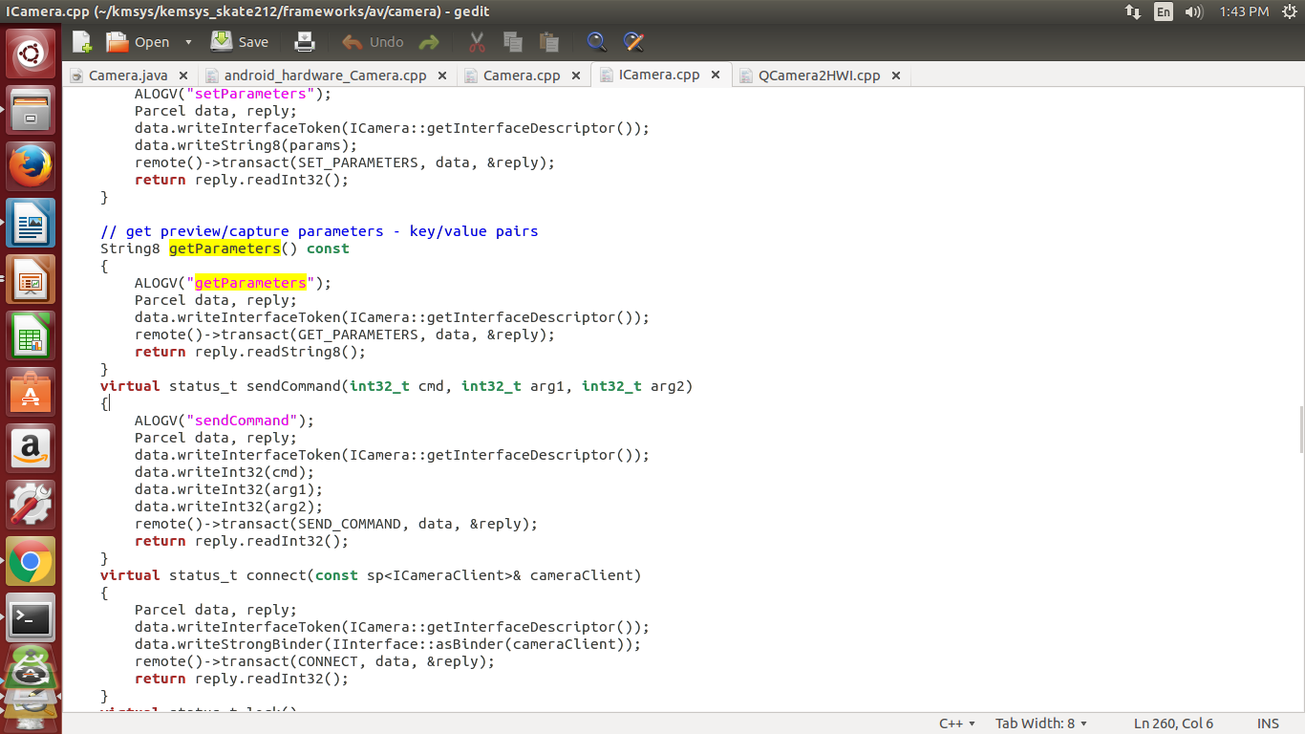
Binder---Framworks /av/ camera/icamera.cpp

Slide 8
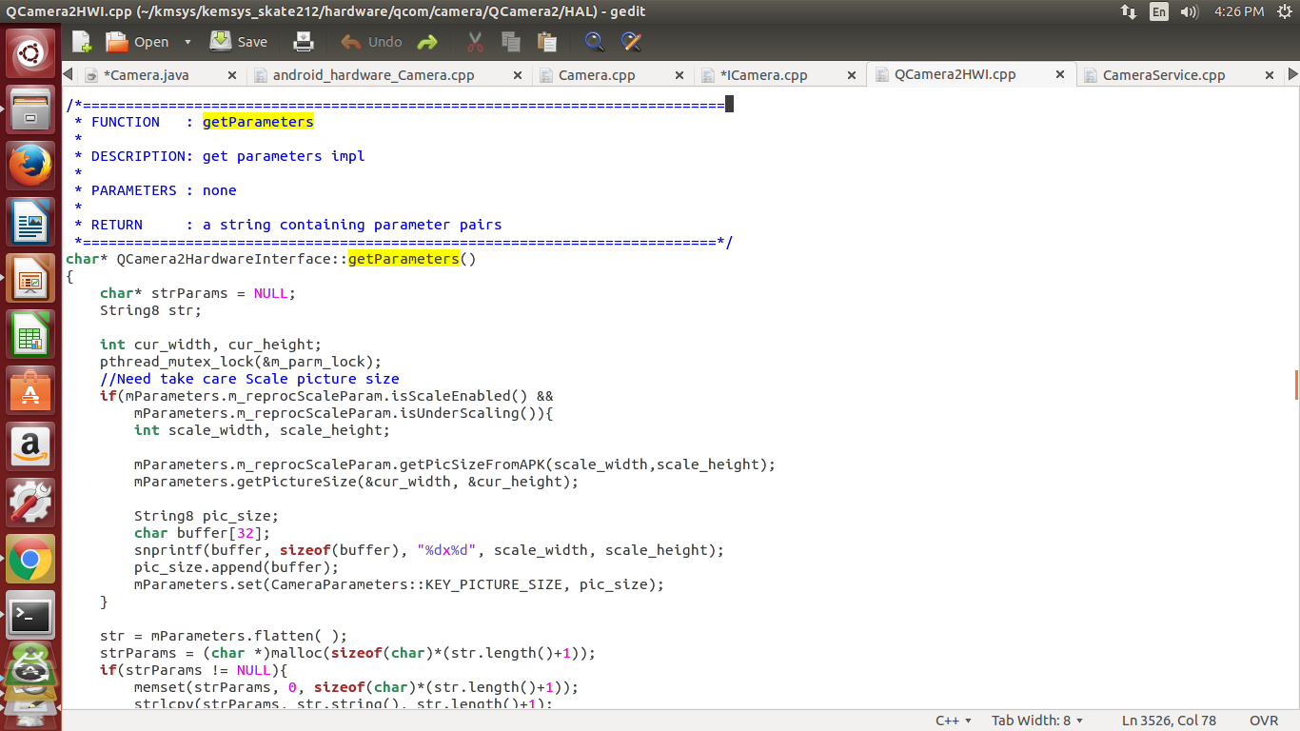
HAL---Hardware/<qcom>/camera/Qcamera2/HAL/Qcamera2HWI.cpp

Slide 9
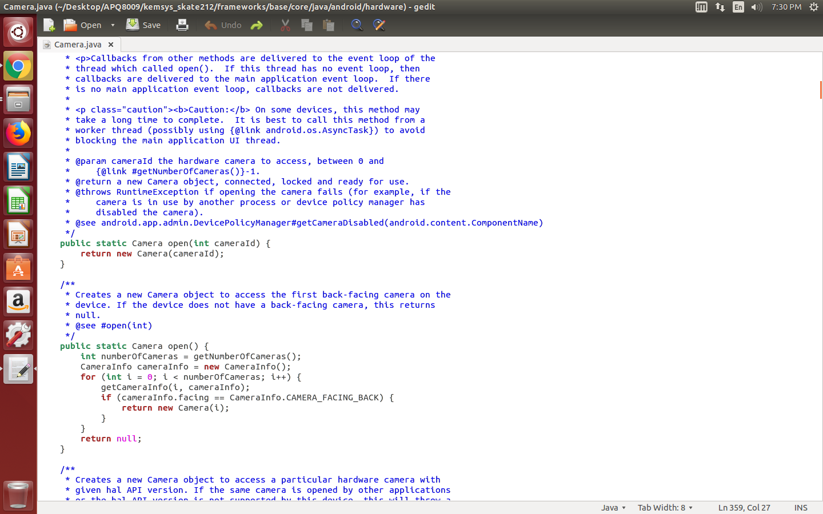
Framwork/base/core/java/android/hardware/camera.java

Slide 10
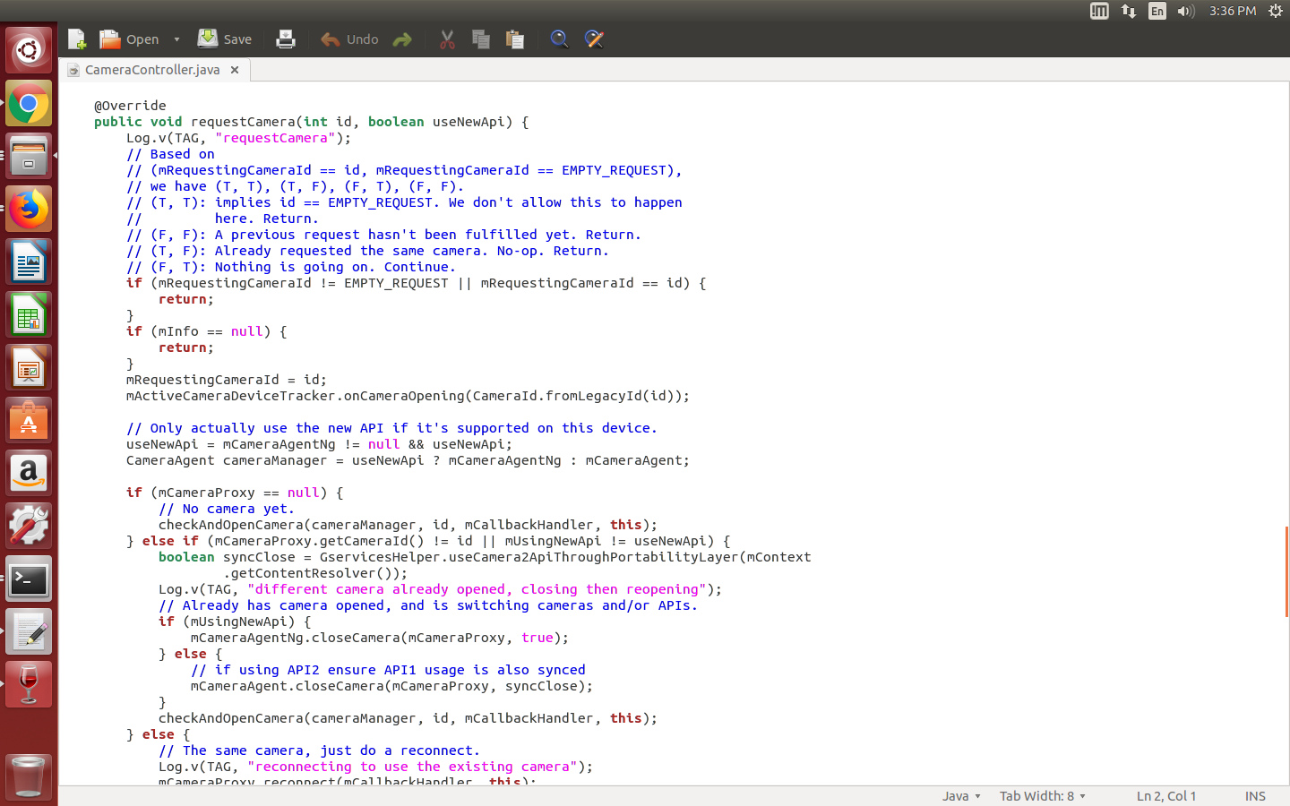
Desktop/APQ8009/kemsys_skate212/packages/apps/Camera2/src/com/android/camera/app/CameraController.java
Continued...
3

Slide 11
5

Slide 12
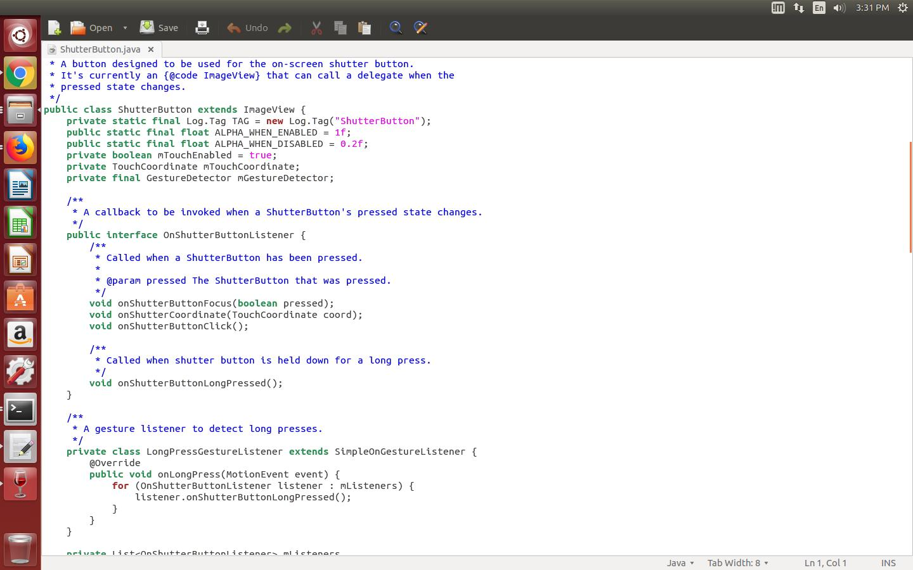
home/thontbee/Desktop/APQ8009/kemsys_skate212/packages/apps/Camera2/src/com/android/camera/ShutterButton.java
Continued...
5

Slide 13
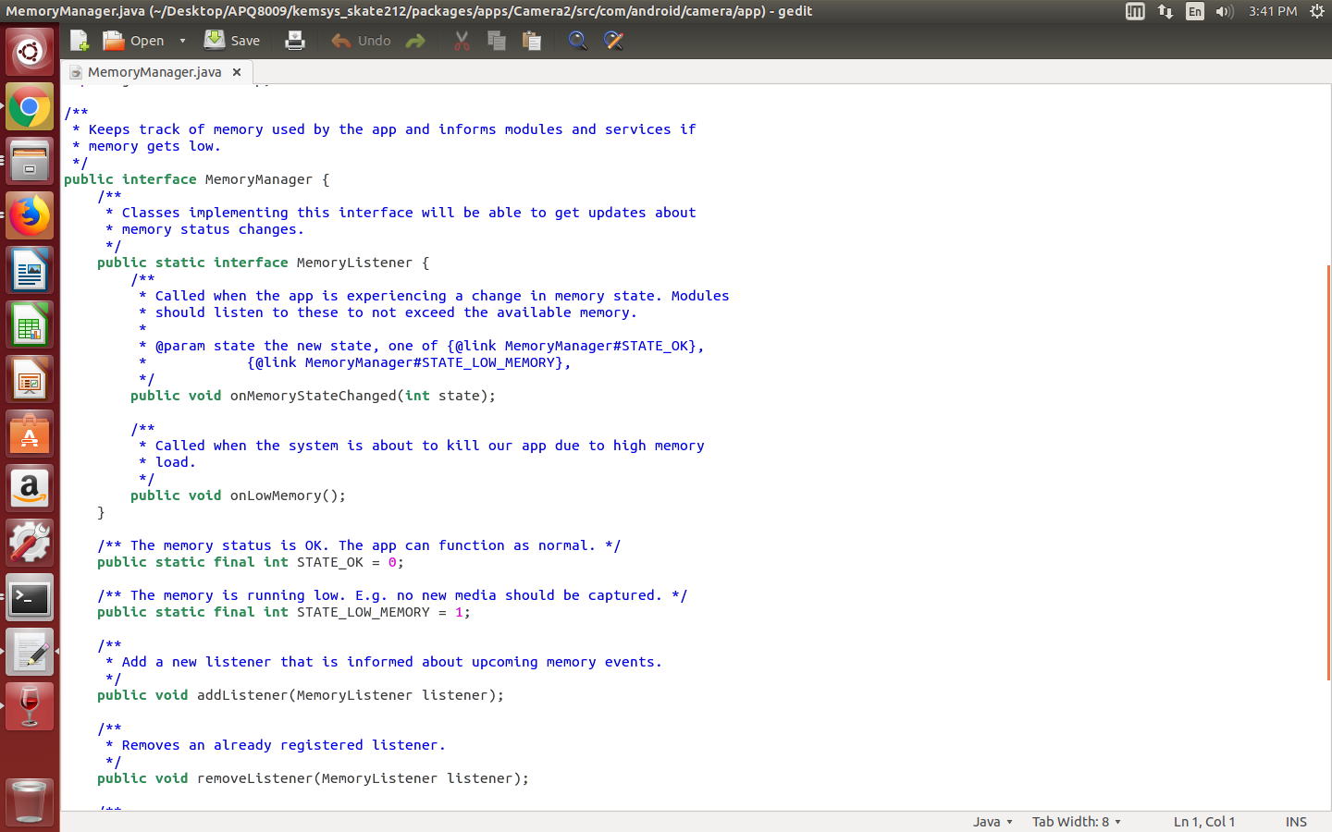
home/thontbee/Desktop/APQ8009/kemsys_skate212/packages/apps/Camera2/src/com/android/camera/ShutterButton.java

Slide 14
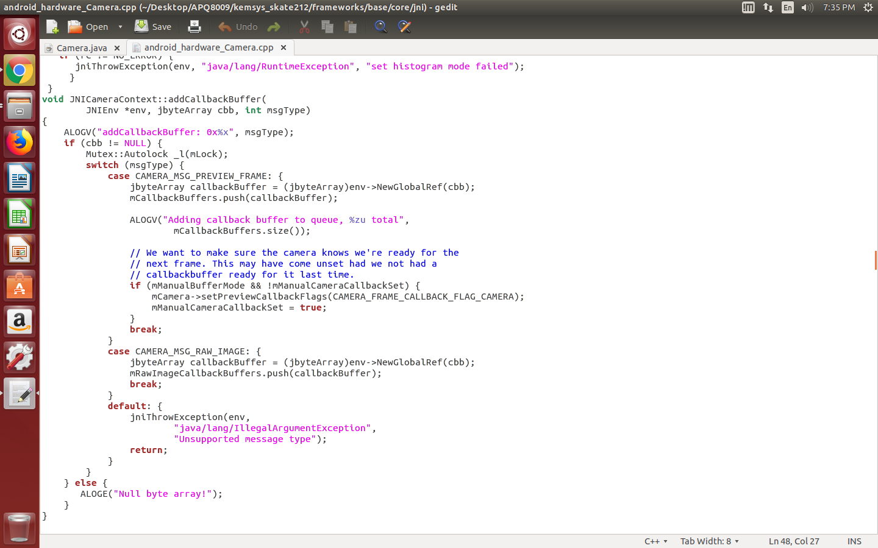
home/thontbee/Desktop/APQ8009/kemsys_skate212/framework/base/core/jni/android_hardware_camera.cpp

Slide 15
home/thontbee/Desktop/APQ8009/kemsys_skate212/packages/apps/Camera2/src/com/android/camera/ShutterButton.java

Slide 16
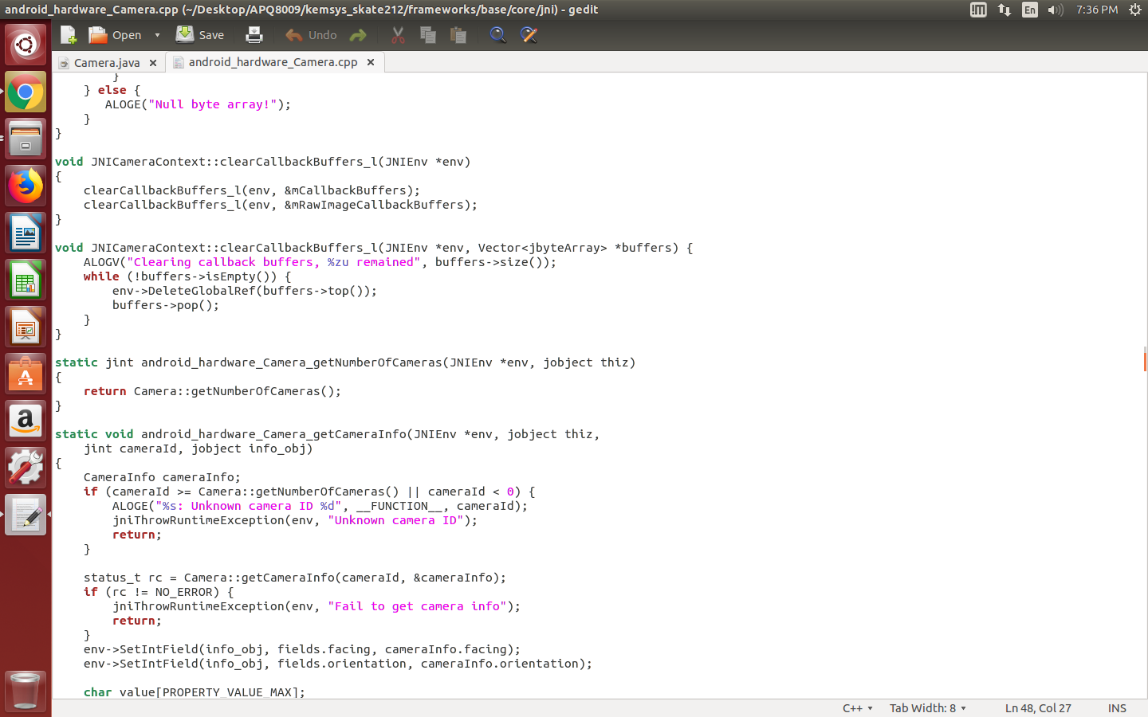
home/thontbee/Desktop/APQ8009/kemsys_skate212/framework/base/core/jni/android_hardware_camera.cpp

Slide 17
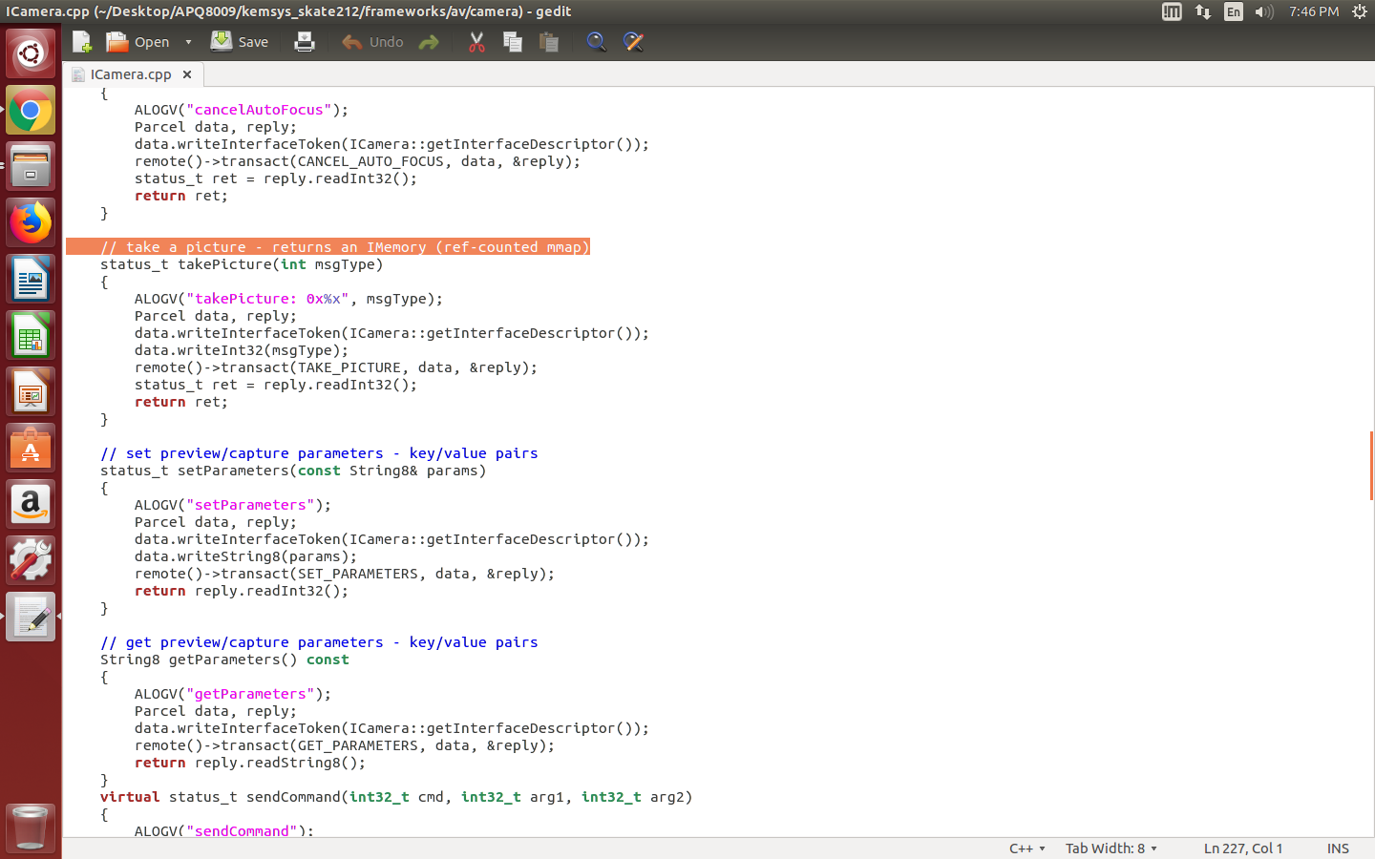
home/thontbee/Desktop/APQ8009/kemsys_skate212/framework/av/camera/Icamera.cpp

Slide 18
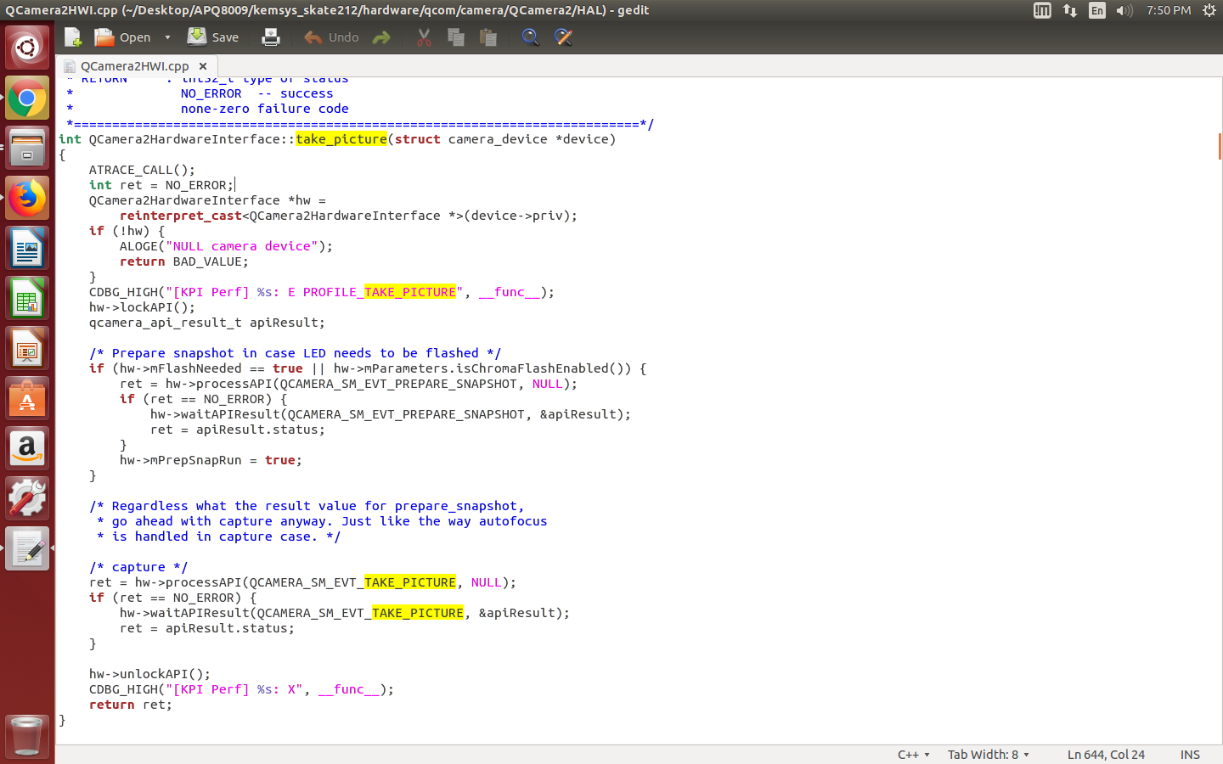
home/thontbee/Desktop/APQ8009/kemsys_skate212/hardware/qcom/camera/Qcamera2/HAL/Qcamera2HWI.cpp

Slide 19
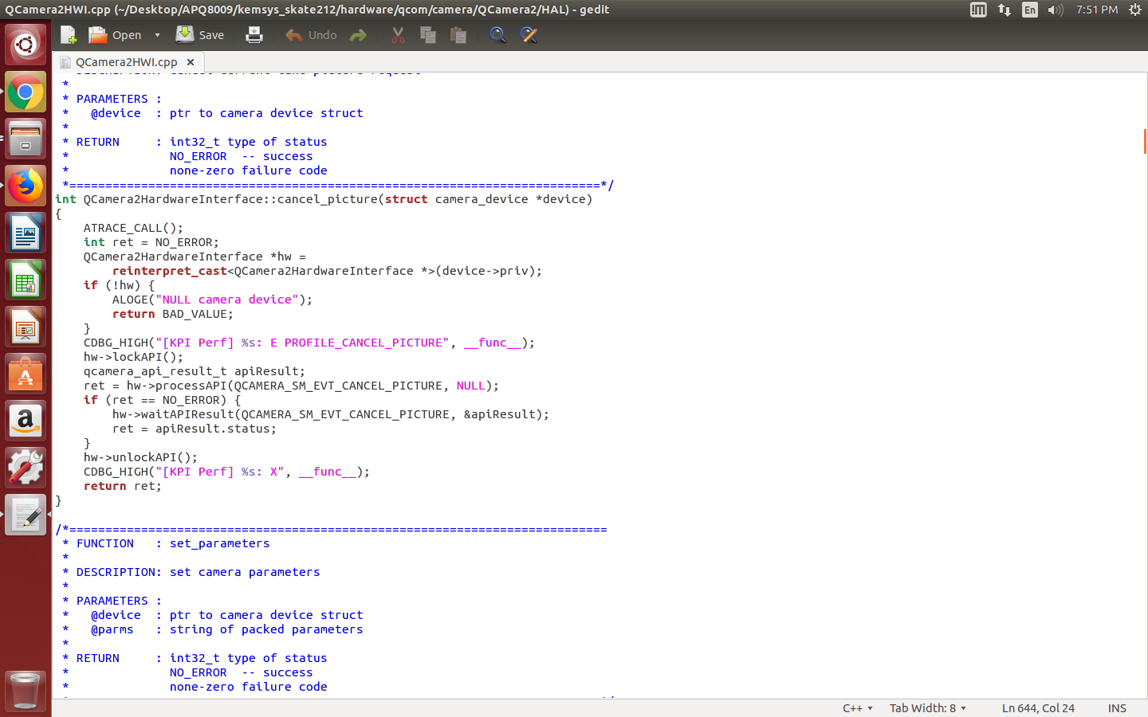

Slide 20
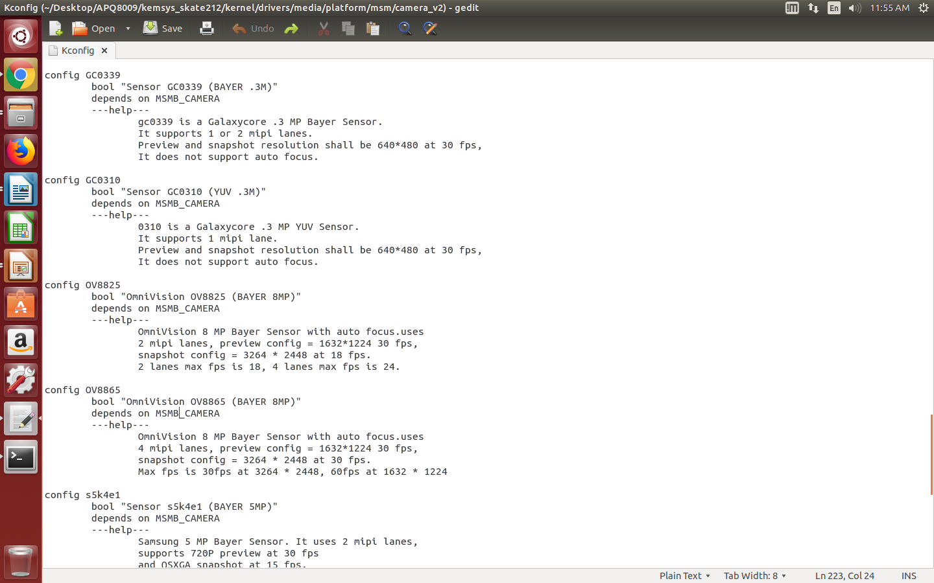
home/thontbee/Desktop/APQ8009/kemsys_skate212/kernel/drivers/media/platform/msm/camera_v2/Kconfig

Slide 21
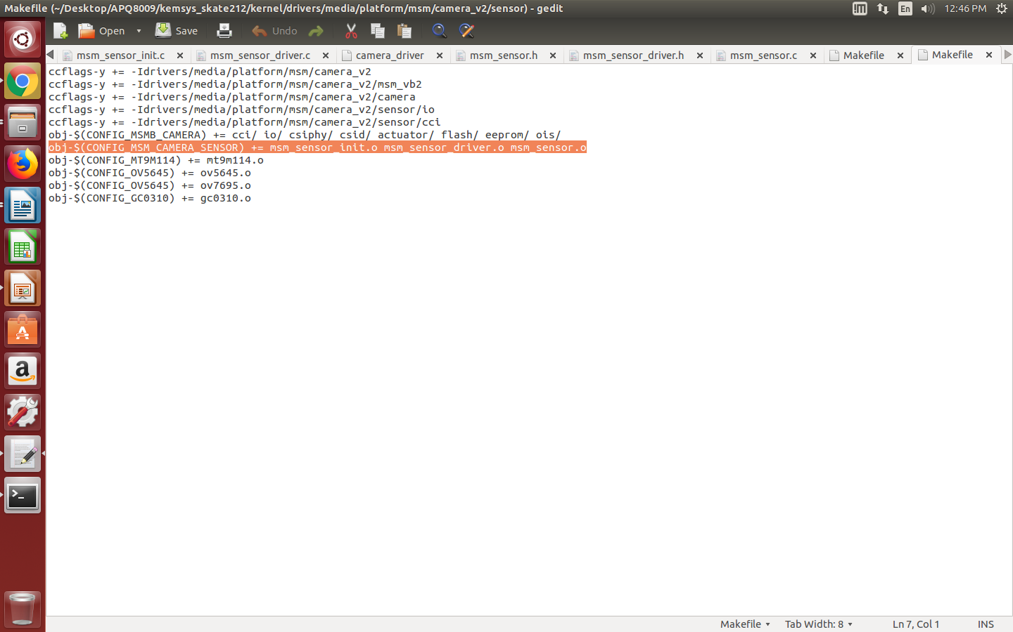
home/thontbee/Desktop/APQ8009/kemsys_skate212/kernel/drivers/media/platform/msm/camera_v2/sensor/Makefile

Slide 22
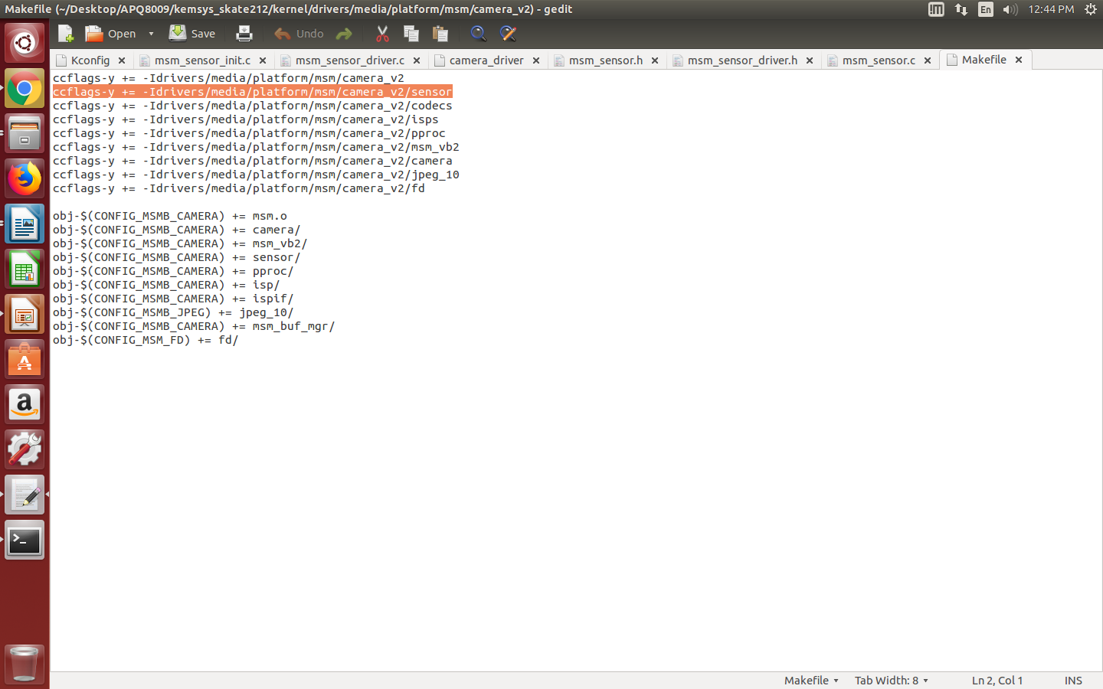
home/thontbee/Desktop/APQ8009/kemsys_skate212/kernel/drivers/media/platform/msm/camera_v2/Makefile

Slide 23
Platform CMOS driver code
home/thontbee/Desktop/APQ8009/kemsys_skate212/kernel/drivers/media/platform/msm/camera_v2/sensor/msm_sensor.c & msm_sensor_driver.c & msm_sensor_init.c

Slide 24

Thank you
8

